Slide 1

Module 6 – Video 3
Segment Pricing
Professor Nico Voigtländer
Management 405: Module 6

Slide 2
OUTLINE of module 6
Simple vs. complex pricing
Direct price discrimination
  Perfect price discrimination (first degree)
  Segment pricing (third degree)
Indirect price discrimination (second degree)
  Versioning
  Coupons
Advanced pricing strategies
  Volume pricing with flat fee
  Two-part tariff
  Block pricing

Slide 3

Third degree price discrimination: segment pricing (group pricing)
Divide customers into different groups with different price sensitivities, and charge each group different prices
Conditions:
  Consumer groups with (on average) different MPV
  Firm can identify these groups
  Firm has market power and can prevent resale

Slide 4
SEGMENT PRicing
Price
  Divide customers into different groups with different price sensitivities
  Charge each group different prices (lower prices to more elastic groups)
P₁
Regular
movie-goers
P₂
Seniors
Demand
Notes:
We reintroduce segment pricing, a concept already introduced in week 2 when we discussed Mercedes’s optimal pricing in the US and Germany, based on different elasticities.
At the car wash, senior citizens get a discount. This is price discrimination based on age. Why do firms select different prices for different segments? We talked about incentives to discriminate when different market segments exhibit different demand elasticities. You want to equate marginal revenue across segments, assuming marginal cost is equal across segments. The implication of this is that you want to charge a lower price for the more elastic segment.
So why are senior citizens more price sensitive?
Going to the car wash is a time consuming activity. It can take 40 minutes, sometimes more for an upscale treatment. Senior citizens can afford to drive around longer for a better deal. Opportunity cost of time. They have lower income, so they are more price sensitive The opportunity cost of time for a senior person is much lower than say for a professional. A professional is concerned about the value of time. Senior citizens don’t care so much about the time component of the cost of the car wash, so they are more sensitive to price.

Slide 5

Segment pricing: student discounts
Notes:
Why would you charge lower price to students? lower incomes and more free time. As a result, they are more price-elastic and it is optimal to offer them discounts.
Important: you need to “verify” that they are indeed students.

Slide 6
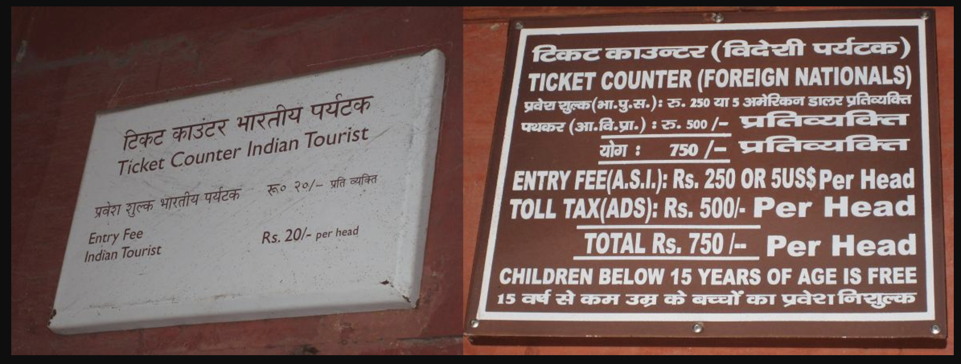
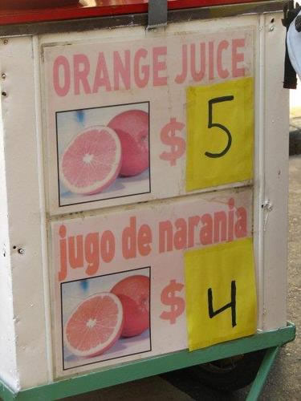
Segment pricing: discounts for locals
Notes:
Disneyland and Taj Mahal: lower prices for Socal/Indian residents compared to tourists. Why? Tourists have lower elasticity of demand than locals that have more easily available alternatives (and in the Indian case, lower income). Generalized phenomenon in tourism – in India airlines used to charge higher fares to tourists.
Another Example: US drugs cheaper in Canada than in USA. There is more discretion as to price in the US because there is less collective bargaining between public entities and pharmaceutical companies for lower prices. This creates incentives for transshipping of drugs – parallel imports to take advantage of arbitrage opportunities.

Slide 7
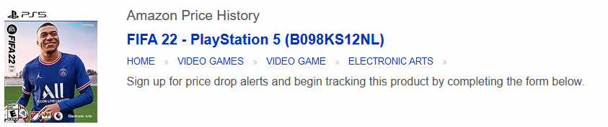
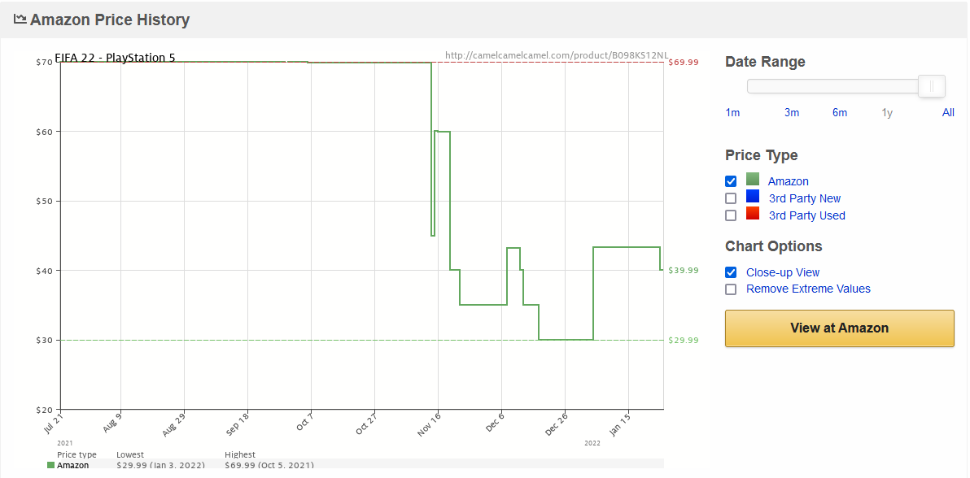
Segment Pricing: Timing
Source: https://camelcamelcamel.com/
Notes:
One can go directly to the website and look for favorite goods. I use coffee moka bialetti:
https://camelcamelcamel.com/

Slide 8
segment pricing: ways to segment consumers
By customer characteristics
  Age, gender,…
  But even by ‘customer’ species: Doctors and veterinarians sometimes use the same medicines.
Discounts for new customers (gym memberships)
By location
  Pharmaceuticals in US v. emerging economies
Intertemporal
  Electronic gadgets: Early adopters vs. Mass market
  Pricing based on search history
  Black Friday
Notes:
For next slide: the price of Lodine for humans is three times the price for animals

Slide 9

Segment Pricing
A firm produces the same product for two markets
  E.g. cars
Should the price be the same in both markets?
Not necessarily!
Set MR_{i}=MC_{i} in each market i
Practice Video!
  Prices different if demand (MR) and/or costs (MC) are different
  Rule: Charge lower price in more elastic markets

Slide 10
Challenges with segment pricing for BMW
Suppose BMW sets very different prices in Germany vs. U.S.
Do you anticipate any problems?
  Arbitrage: re-importation from the cheaper market
    Difficult in this particular case (e.g., miles vs kilometers; taxation).
    However, easier in other cases (e.g., buying textbooks in India and reselling them in the US)
  Consumer backlash

